Slide 1
SALES DATASET ANALYST -ADVANCED EXCEL PROJECT
NAME :AJAY
DATE :21/04/2025
COURSE : DA&DS
BATCH:MARCH-ONLINE

Slide 2
OBJECTIVE: ANALYZE SALES DATA TO UNCOVER TRENDS AND ACTIONABLE INSIGHTS
GOALS :
 TRACK SALES PERFORMANCE GIVEN DATASET.
 IDENTIFY BEST- SELLING PRODUCTS ABD SALES CHANNEL LIKE (SHIP MODE)
 ANALYZE DISCOUNT IMPACT.
 BUILD DYNAMIC DASHBOARDS .

Slide 3
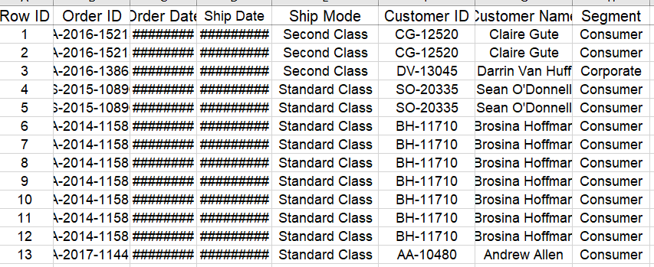
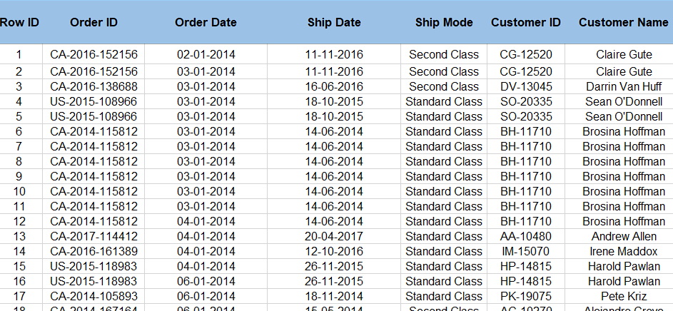
Data Description and Cleaning
RAW DATA
Source: Superstore Sales Dataset
Size: Approx. 10,000 rows
Cleaning Steps:
Removed duplicates
Corrected negative sales/discounts
Formatted dates and currency
CLEANED DATA

Slide 4
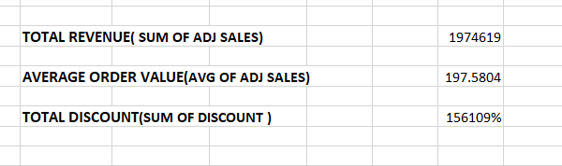
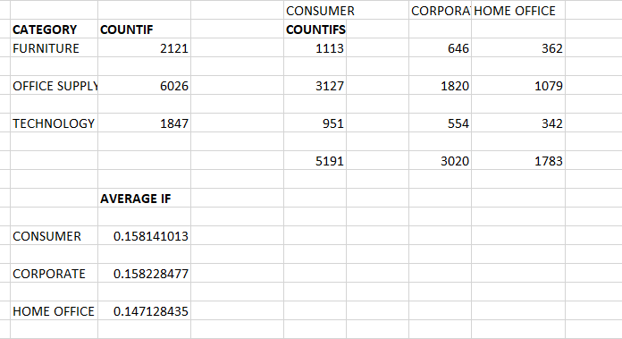
KEY METRICS & FORMULA
METRICS
EXCEL FUNCTIONS

Slide 5
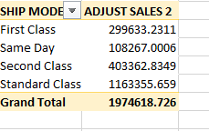
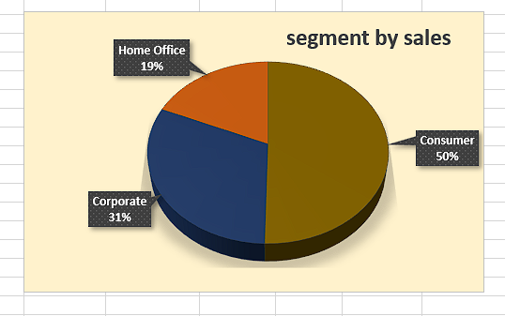
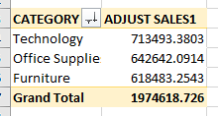
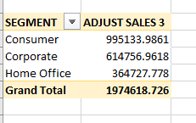
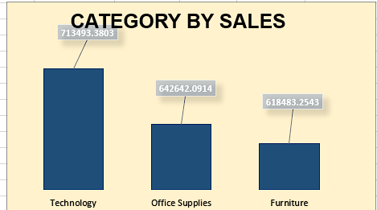
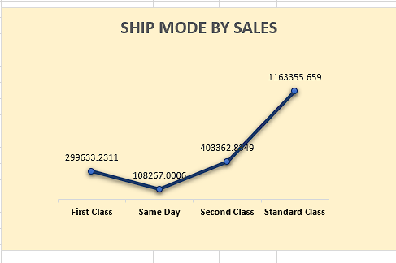
PIVOT TABLES & CHARTS
PIVOT TABLES
PIVOT CHARTS

Slide 6
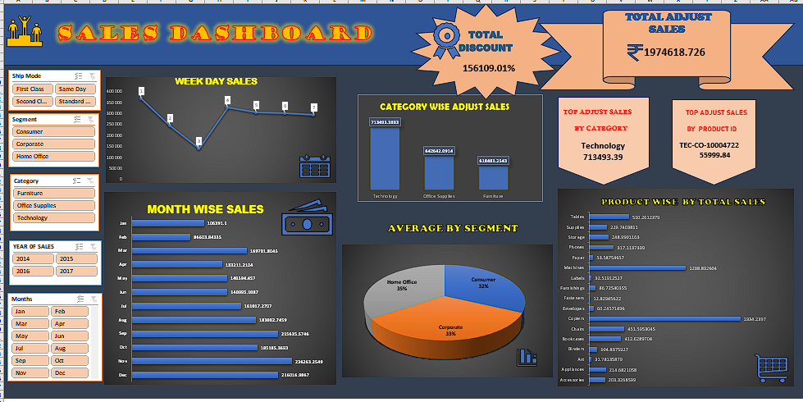
DASHBOARD OVERVIEW
✵ SALES DASHBOARD WITH ALL KEY METRICS &SLICERS ITS ESTABLISHED ALL TRANSACTION DATA SET.

Slide 7
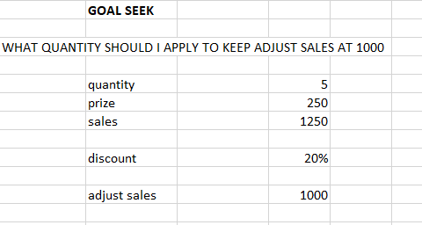
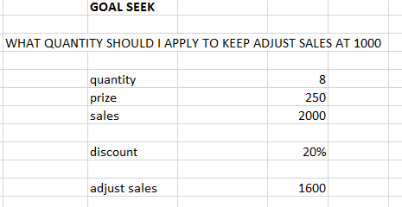
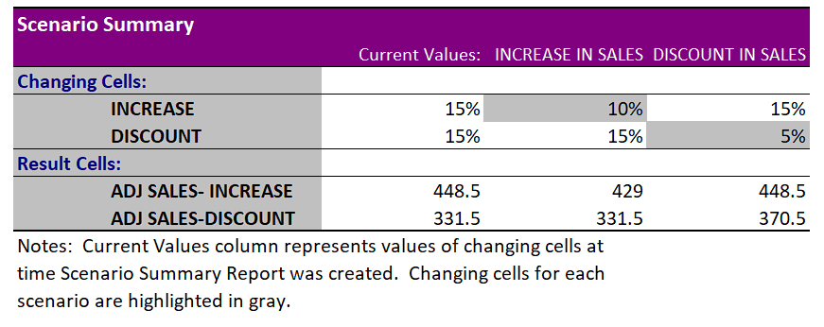
WHAT IF ANALYSIS & GOAL SEEK .
GOAL SEEK ;
❖ QUANTITY NEEDS TO ADJUST SALES 1000 I USE GOAL SEEK AND FIND QUANTITY FOR 1000 ADJUST SALES
AFTER
BEFORE
SCENARIO MANAGER
➢ WHEN YOU USE MULTIPLE VALUES TO CHECK , USE SCENARIO MANAGER.
➢ ALWAYS HELPS YOUR NEED AND SHOW ALL SUMMARIES.

Slide 8
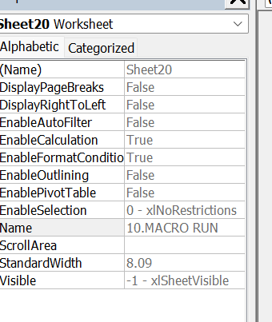
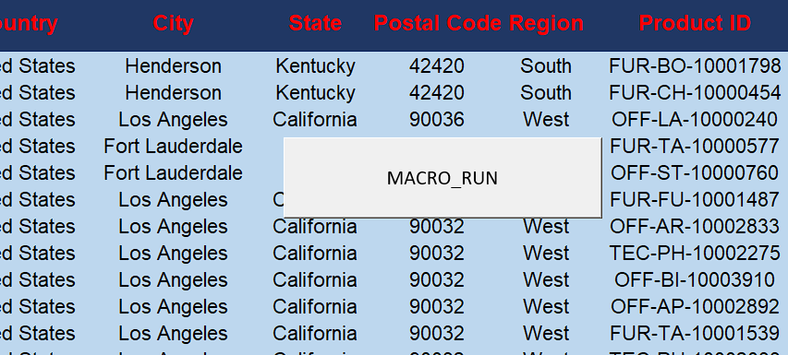
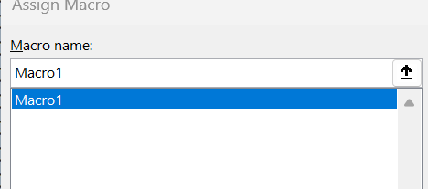
MACROS & AUTOMATIONS
VBA CODE
➢ FORMATTING.
➢ CALCULATIONS.
➢REPORT GENERATION.
➢ MACRO BUTTON
MACRO BUTTON
ASSIGN MACRO
➢ USE MACRO FOR AUTOMATION TASK THIS FEATURE USED CAREFULLY .
➢ MACROS IN FEATURE AUTOMATION MAKE SURE SOME COPIES TAKE SHEET THEN ASSIGN MACRO.

Slide 9
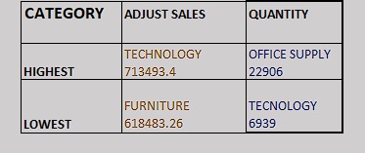
INSIGHTS & RECOMMENDATIONS
Key Insights:
Best: Technology Category & Standard Class shipping
Seasonal trends in Nov–Dec
Recommendations:
Optimize discount policy
Focus on profitable product segments
Improve low-performing areas

Slide 10
CONCLUSION
Summary:
Cleaned and analyzed data
Built interactive dashboards
Delivered actionable business insights
Next Steps:
Predict future sales
Deeper customer analysis
IDEAS :
MONITORING RETURNING PRODUCT AND FOCUS THAT CATEGORY .
CHECK CUSTOMER FEED BACK DAILY EVERY PRODUCT SALES .
➔ ANALIZE IS CUSTOMER NEED THEN GIVE DISCOUNTS.
THANK YOU…….

